Slide 1
Optimizing Elligator 1 on Curve1174
Christopher Vogelsanger, Freya Murphy, Miro Haller

Slide 2
Introduction

Slide 3
Slide Title
Introduction (< 1 min) (Freya)
Explain Elligator (1 min)
Idea
Formulas for mappings
Curve1174

Slide 4
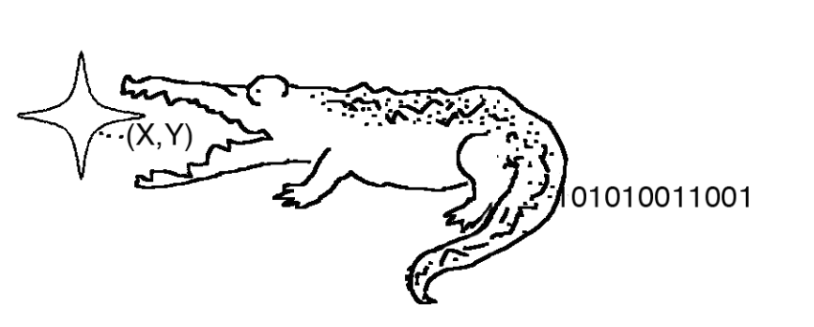
Elligator
Elligator: Elliptic-Curve points indistinguishable from uniform random strings. [1]
Helps prevent censorship of obvious curve points
[1] D. Bernstein et al. Elligator: Elliptic-curve points indistinguishable from uniform random strings. ACM Conference on Computer and Communications Security 2013. 2013.
Notes:
Algorithm proposed in paper by Bernstein et al. in 2013.
Mapping between points on an elliptic curve and uniformly random strings
Helps prevent censorship because only random-looking strings are transmitted, not obvious curve-points.
The paper describes 2 algorithms: Elligator 1 and Elligator 2
Elligator 1 uses a new Curve proposed in the paper, Curve1174, which is optimised for the mapping.
Elligator 2 performs the mapping on pre-existing curves, e.g. Curve25519, but requires extra steps.
We chose Elligator 1 because it is simpler, just focuses on the Elligator mapping.
Implemented both forward and reverse mapping

Slide 5


Elligator mapping
Forward mapping (string to point)
Inverse mapping (point to string)
Notes:
Problem comes down to implementing a series of equations on Big Integers
\begin{aligned}
\eta &= \frac{y - 1}{2(y + 1)}, \\
\bar{X} &= -(1 + \eta r) + ((1 + \eta r)^2 - 1)^{(q + 1)/4}, \\
z &= \chi((c - 1)s\bar{X}(1 + \bar{X})x(\bar{X}^2 + 1/c^2)), \\
\bar{u} &= z\bar{X}, \\
\bar{t} &= (1 - \bar{u})/(1 + \bar{u})
\end{aligned}

Slide 6
Straightforward C Implementation

Slide 7
Slide Title
Straightforward implementation (2 min)
Framework (1 min)
Check Unit tests (Miro)
CI/CD
Benchmarks (Chris -> what)
Helper functions (Miro -> how)
Makefile & automated setup (Miro)
No reference implementations (Freya)
-> GMP and Sage one written by us
BigInt with malloc (< 1 min) (Miro)

Slide 8
Build, Test, and Benchmark Environment
Unit testing framework: Check [1]
Organized in test suites and test cases
Nice test result report
GitLab CI/CD Pipeline Integration
[1] https://libcheck.github.io/check/
Notes:
Check
Professional framework
Runs in separate address space -> can catch error signals/segfaults
Report with successful / failed test cases and information on error.
E.g., wrong result, or abort at line XYZ
Integrated into Git CI/CD pipeline
runs tests for every commit, reports failures by e-mail
(CI/CD: Continous Integration Continuous Delivery/Deployment)

Slide 9
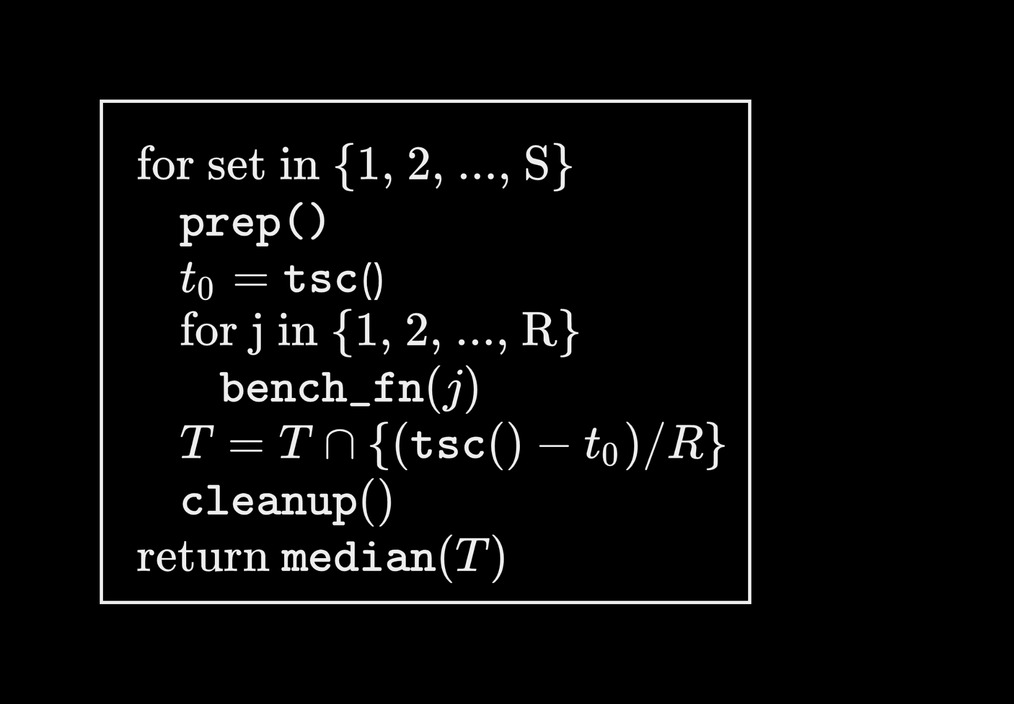
Build, Test, and Benchmark Environment
Benchmarking Library
Takes prepare, benchmark, and cleanup function
Execute benchmark function in S sets each with R repetitions
Take median
Benchmarks
Measure runtime of all functions
Count function calls
Count integer operations
Notes:
Benchmarking Library
Helper library
Call with 3 functions + arguments
Prepare the benchmark (e.g., initialize random variables)
Function to execute and time
Cleanup (free variables)
S sets:
Start timer
Do R function calls
Stop timer
Take median over time/reps
Benchmarks
Since we do not have variable input sizes we measure runtime of all functions
Helps to find bottle necks and visualize improvements
We keep count of function calls for the same reason
We decided to count integer ops ourselves

Slide 10
Build, Test, and Benchmark Environment
Makefile integration
Compiling
Running
Testing
Plotting
Notes:
[In the interest of time, probably skip this]
Compiling, running, testing, and plotting integrated into Makefile targets
Saves time, makes collaboration easier (hide device specific compilation)

Slide 11
Reference Implementations
Could not find any available implementations
Elligator website mentions a Sage implementation [1].
We made our own Sage implementation
BigInt arithmetic:
GMP (The GNU Multi Precision Library) [2]
Used to benchmark BigInt operations and Elligator mapping
[1] https://elligator.cr.yp.to/software.html
[2] https://gmplib.org
Notes:
Most implementations we found online were for Elligator 2.
Sage implementation source code is not available online, only mentioned on website.
They report some figures for the Sage implementation but it is for Elligator 2 (Curve25519)
Wrote our own Sage implementation as a quick baseline and to verify our results
GMP library is a reference implementation for generic BigInt arithmetic.
As well as benchmarking GMP functions against our own BigInt ops, we wrote an Elligator implementation using GMP.
Based on our naive V1 implementation, just swapped out our big_int calls for respective GMP functions.
Many future optimisations wouldn’t have been possible in GMP because we wrote curve specific functions, etc.

Slide 12
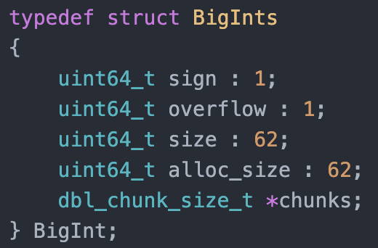
Straightforward BigInt Library
BigInt allocates alloc_size 64-bit chunks of memory
size chunks are currently used
Big integer arithmetics
“The Art of Computer Programming” [1]
Clean code & convenient interface
Allows aliasing names, nested calls
Explicit error messages
[1] Knuth, Donald Ervin. The Art of Computer Programming. Volume 2, Seminumerical Algorithms. 3rd ed. Place of publication not identified: Addison Wesley, 1997. Print.
Notes:
Arbitrary size BigInt consists of chunks (official term: limbs)
Big integer add, sub, mul, and div after pseudo code from “The Art of Computer Programming”
Smart algorithms, not the naive version, (maybe not the most optimized one either)
Division is BY FAR the most complex operation
Clean code and convenient interface
Easy to use, no assumptions made on arguments
Explicit input validation, printing warnings and errors

Slide 13
Cost Analysis

Slide 14
Slide Title
Cost analysis (spread across) (< 1 min)
Integer ops (Chris)
Our cost function (Chris)
Roofline plot (Miro)
Stat count
Many mem functions -> remove them in V2 (Freya)

Slide 15
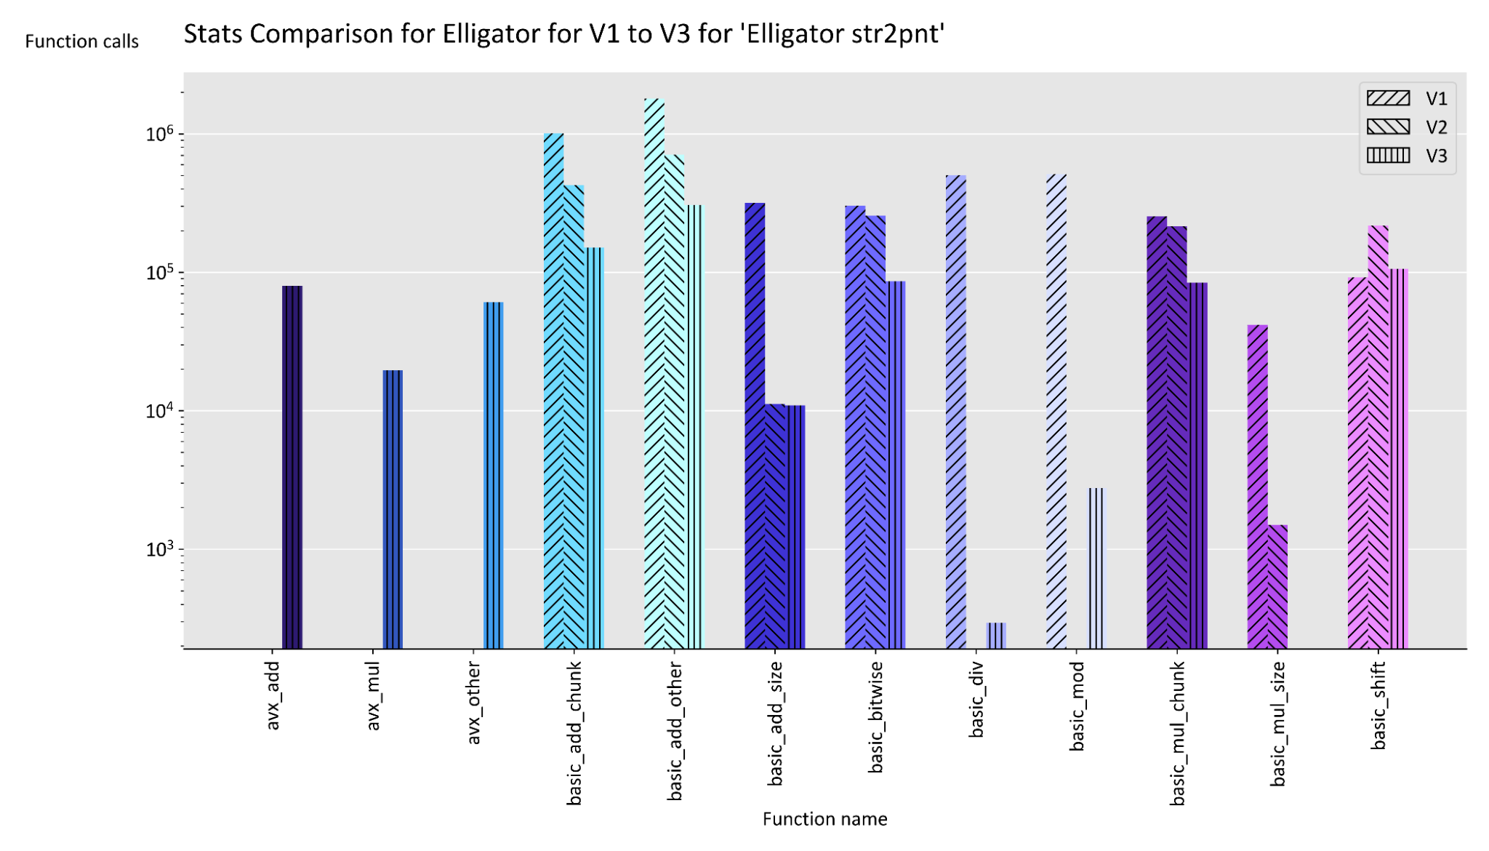
Integer Operations
Keep track of following iops
Add/Sub
Mul
Div
Mod
Shift
Bitwise
Cost function:
C(x) = Σ iops(x)
Add up all integer operations
Notes:
We keep track of all the integer operations and define our cost function as a sum of it
----
Numerical instruction mixes:
Instruction mix for V1, inv map:
- ALU: 0.79%
- SHIFT: 0.02%
- MUL: 0.07%
- DIV: 0.12%
Instruction mix for V1, map:
- ALU: 0.79%
- SHIFT: 0.02%
- MUL: 0.07%
- DIV: 0.12%
Instruction mix for V2, inv map:
- ALU: 0.76%
- SHIFT: 0.12%
- MUL: 0.12%
- DIV: 0.0%
Instruction mix for V2, map:
- ALU: 0.76%
- SHIFT: 0.12%
- MUL: 0.12%
- DIV: 0.0%
Instruction mix for V3, inv map:
- ALU: 0.77%
- SHIFT: 0.12%
- MUL: 0.11%
- DIV: 0.0%
Instruction mix for V3, map:
- ALU: 0.77%
- SHIFT: 0.12%
- MUL: 0.12%
- DIV: 0.0%

Slide 16
Roofline Plot
Main optimization target:
MacBook Pro Mid 2015
Intel Haswell i7-4980HQ 2.8 GHz
Apple clang version 12.0.0
Ports with execution units for integers [1]
Port 0 | Port 1 | Port 5 | Port 6
ALU Shift | ALU | ALU | ALU, Shift
Divide | Slow int
[1] Intel 64 and IA-32 Architectures Software Developer's Manual - Volume 3B Intel Corporation, September 2019
Notes:
Only the relevant execution units are shown (i.e., the ones for integer operations)

Slide 17
Roofline Plot
Peak performance
Without vectorization: 4 iops/cycle
With vectorization: 16 iops/cycle
Assuming 64-bit integers
Memory bandwidth
Novabench: ≅25 GB/s
8.9 B/cycle
[1] Intel 64 and IA-32 Architectures Software Developer's Manual - Volume 3B Intel Corporation, September 2019
Notes:
Peak performance
Without vectorization: 4 iops/cycle because 4 ALUs on different ports
With vectorization: 16 iops/cycle since 4x64-bit integers in one vector
Memory bandwidth
Measured with benchmark tool, not the manufacturer-given ideal memory bandwidth

Slide 18
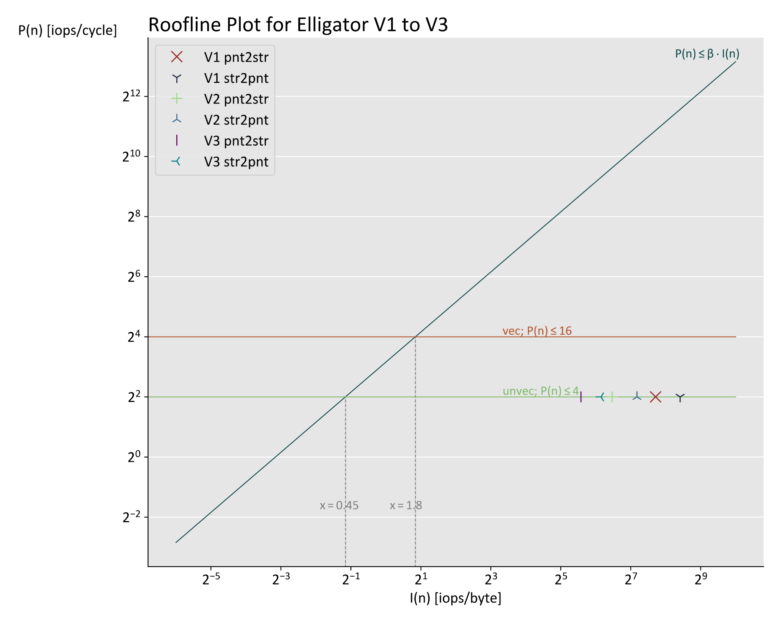
Roofline Plot
Notes:
Reduced #ops for every new version
Fewer ops -> lower work -> lower intensity I(n) -> moves to left
heavily compute bound (mind log-log axes! -> far away from intersection)

Slide 19
Non-Vector Optimizations

Slide 20
Slide Title
V2 Optimizations (4 min)
Simple optimizations
Stack vs. heap (Freya)
Strength reduction (Chris, Freya)
Precomputation (Chris)
Algorithmic changes
Mod (Miro)
Square (Chris)
Special pow -> chi (Miro)
Check notes (everyone)
Add plots for improvements (Miro)

Slide 21
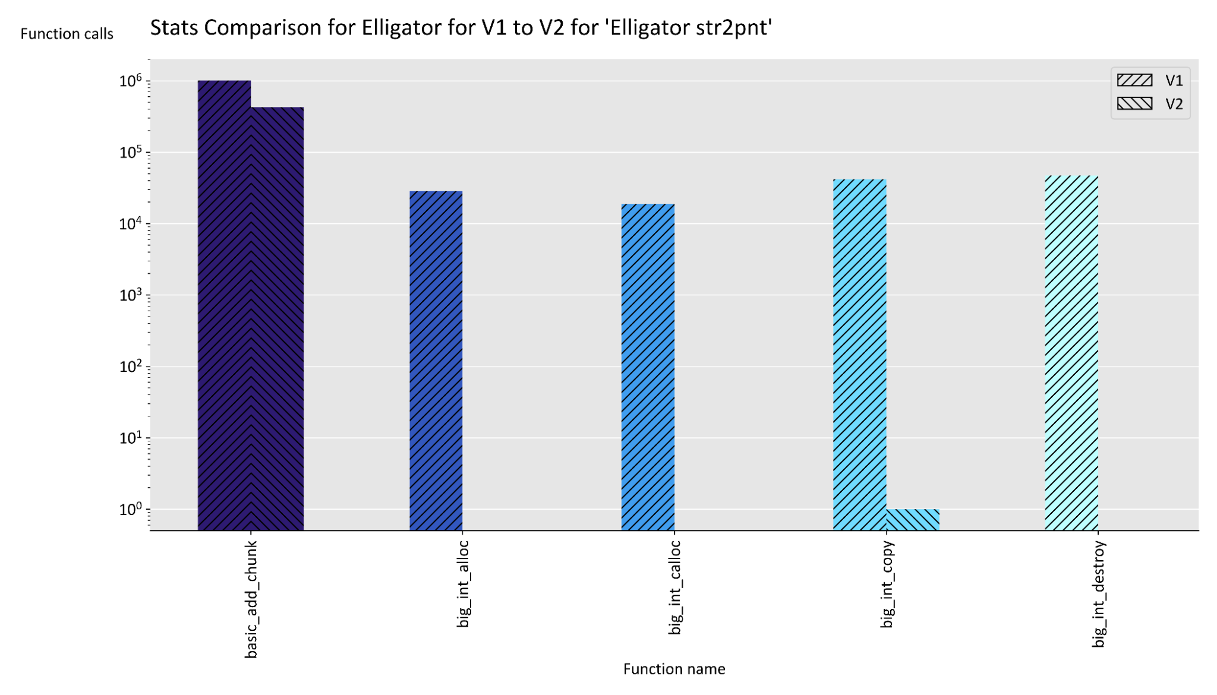
Memory Operations
Notes:
We noticed we had a lot of memory operations that were taking a significant amount of time.
See how we have ~10^6 add ops and ~10^4 alloc ops.
We used this information to inform our optimisations, e.g. refactoring to reduce memory operations.
In the end we removed almost all memory ops, only a single copy remains.

Slide 22
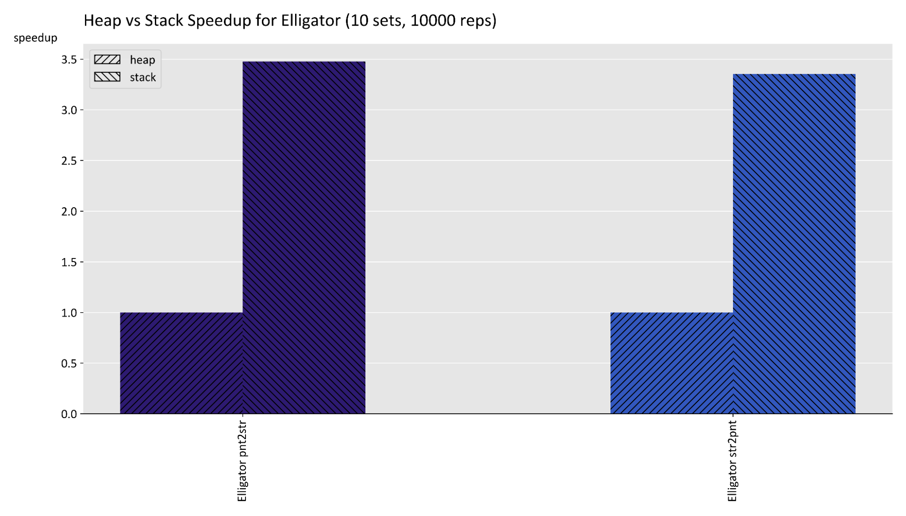
Stack vs Heap
Notes:
To reduce memory operations we allocated Big Ints on the stack instead of the heap.
This alone caused a significant decrease in runtime (see plot)

Slide 23
Basic Optimizations
Replace ‘mod power of 2’ with bitwise AND
Replace power of 2 divisions by right-shift
Assume no aliasing in BigInt parameters
Create specific functions
Single chunk multiplication
Power with integer exponent
Remove multiplications by χ
Loop unrolling
Pre-computation
Optimization flags
Compile all at once
Notes:
Some regular int calculations were done modulo the BigInt radix. These were replaced by a bitwise AND with the radix - 1.
Regular divisions by the radix were replaced by shift operations.
Some big int divisions were also able to be replaced by shifts.
V1 code took copies of BigInt parameters in case of aliasing (e.g. output is written to one of the input parameters)
Assumed to aliasing so we could remove these copies
Required some code to be rewritten to more creatively use variables to avoid aliasing. (e.g. pow)
Created some application specific functions to improve on general BigInt implementations
Curve1174 functions with hard-coded modulus
Separate functions for common input sizes
Could be unrolled/optimised more easily than general functions
Square function has less data movement
Chi can only have value -1, 0, 1 so rather than multiplying we can just change the sign of the other operand accordingly.
0 case doesn’t occur

Slide 24
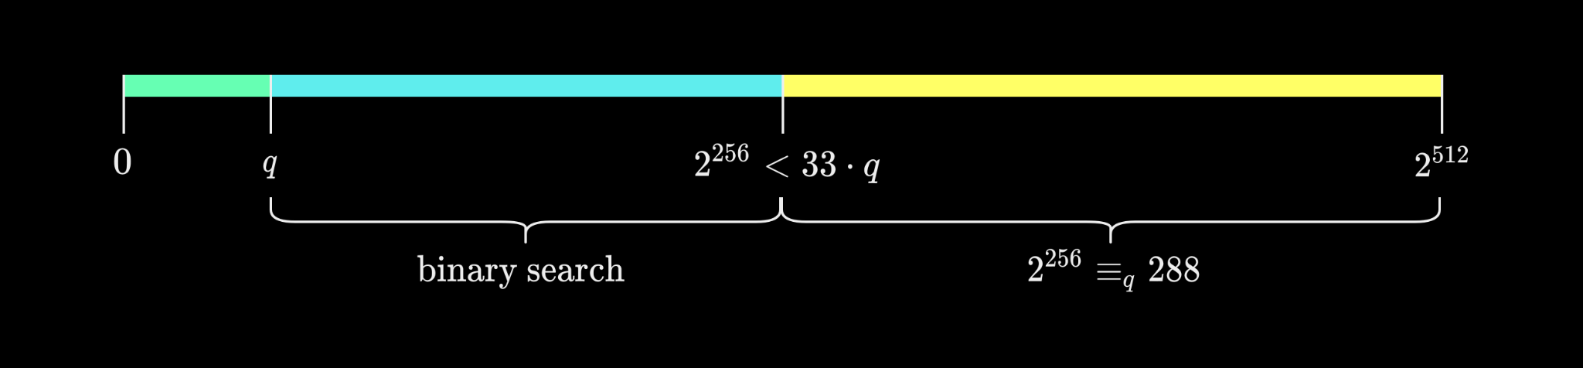
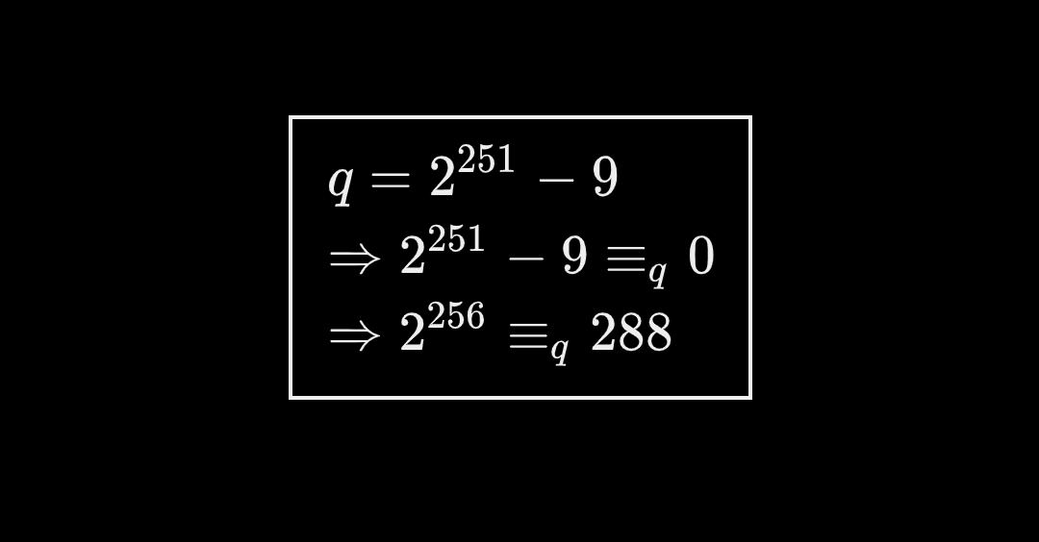
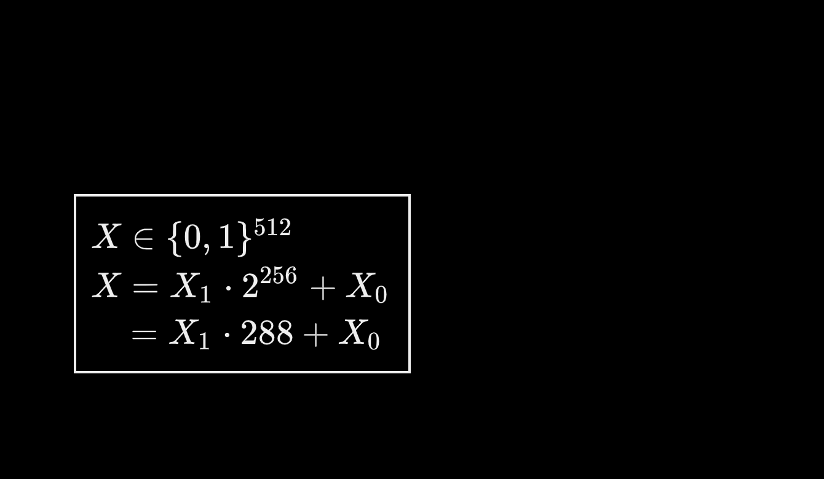
Algorithmic Optimizations – mod
Normally, mod requires division with rest
Special prime of Curve1174
Recursion necessary
Only works for X ≤ 2²⁵⁶
Binary search with precomputed values
Search a ∈ [1, 32] s.t. 0 ≤ X - aq < q
Notes:
In general, mod requires us to do division with rest
Divrem is most complicated function
Really difficult to optimize -> many dependencies
Special prime q = 2^251 - 9 was chosen because it is close to a power of two
We can split a 512-bit block into an upper (X_1) and lower (X_0) 256-bit block
Then replace * 2^256 with * 288
→ simple multiplication instead of expensive division!
But the result could be larger than q, or even 2^256 -> recursion
For binary search:
Search a * q for a in [1, 32] such that 0 <= X - a*q < q
Precomputed values a*q
Cheap comparisons to find this multiple
1 subtraction

Slide 25
Algorithmic Optimizations – Square
Special case of multiplication
Reduce memory access
Only one operand
Can save around half the chunk multiplications
 |  |  | a₀a₃ | a₀a₂ | a₀a₁ | a₀a₀
 |  | a₁a₃ | a₁a₂ | a₁a₁ | a₁a₀
 | a₂a₃ | a₂a₂ | a₂a₁ | a₂a₀
a₃a₃ | a₃a₂ | a₃a₁ | a₃a₀
Notes:
Pending

Slide 26
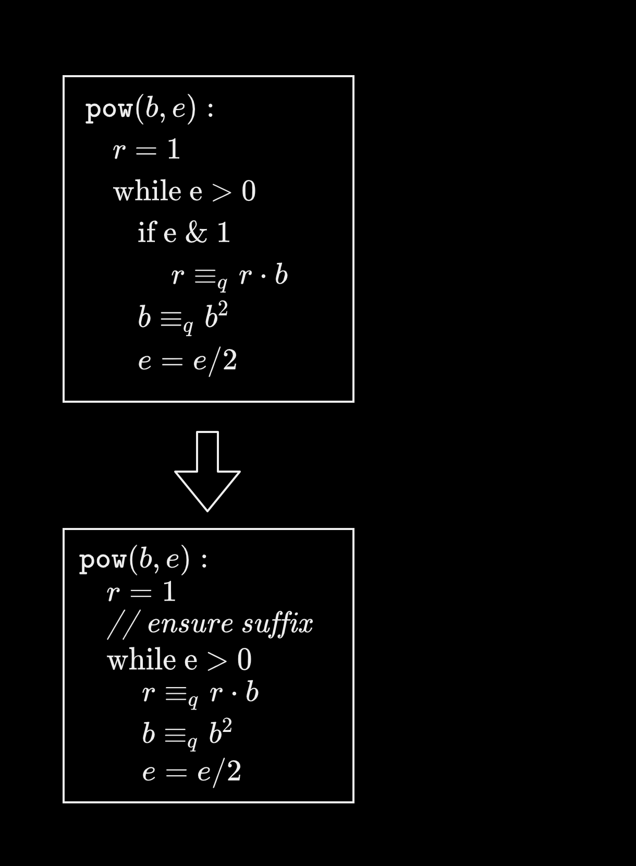
Algorithmic Optimizations – special pow
Multiple special power operations
Chi: χ(a) = a^{(q-1)/2}
Inverse mapping: ɑ^{(q+1)/4}
Fermat inverse: a⁻¹ ≡ a^{q-2} (mod q)
Exponents have prefix of ‘ones’:
(q-1)/2 = 0b1111...11111011 (247 ones in prefix)
(q+1)/4 = 0b111111...111110 (248 ones in prefix)
q-2 = 0b11111...1110101 (247 ones in prefix)
Ensure suffix separately
Remove branching from square-and-multiply
Enables AVX optimizations (later)
Notes:
We have three power operations that are used multiple times
They are the most significant bottleneck
The exponents have a special structure that we can exploit
The many one bits mean we always multiple the power of the base to the result
This enables AVX optimizations that we’ll discuss later

Slide 27
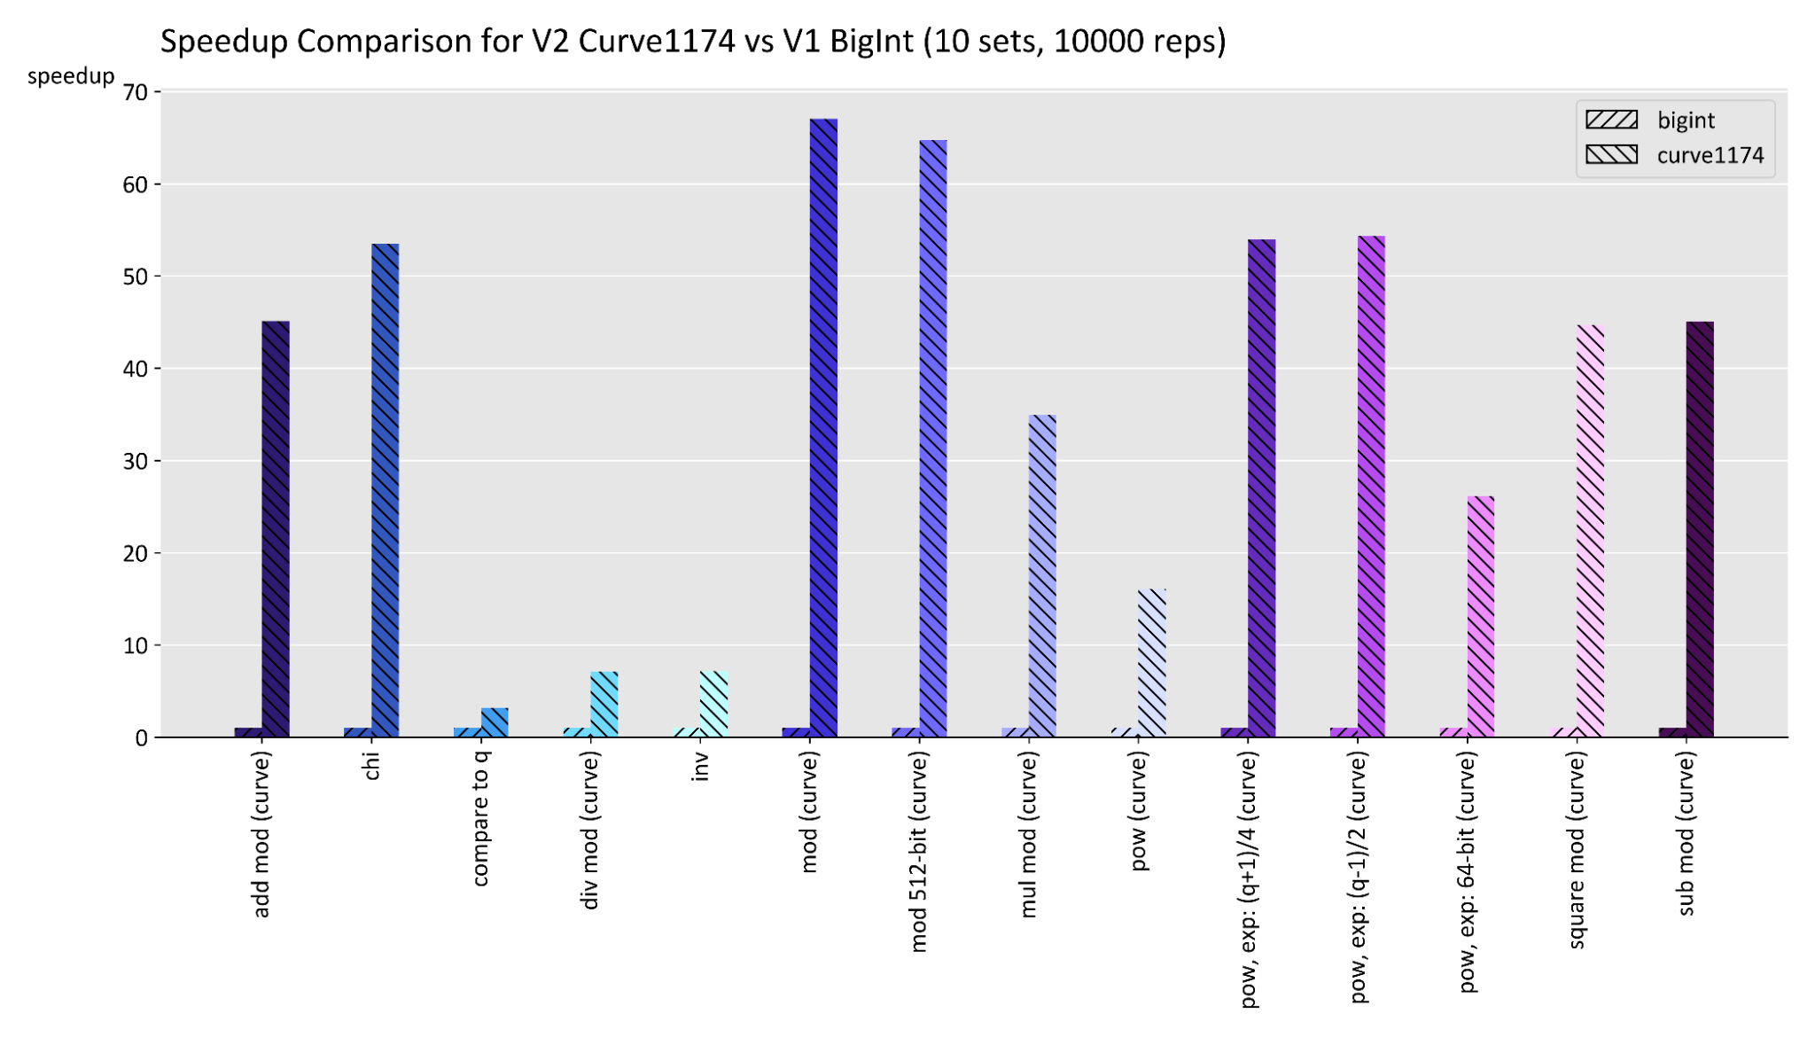
Algorithmic Optimizations – speedup

Slide 28
Vector Optimizations

Slide 29
Slide Title
V3 AVX (1 - 2 min)
Add, (sub), mul didn’t improve (Chris)
Mul with 4 indep. arguments (Chris, Miro)

Slide 30
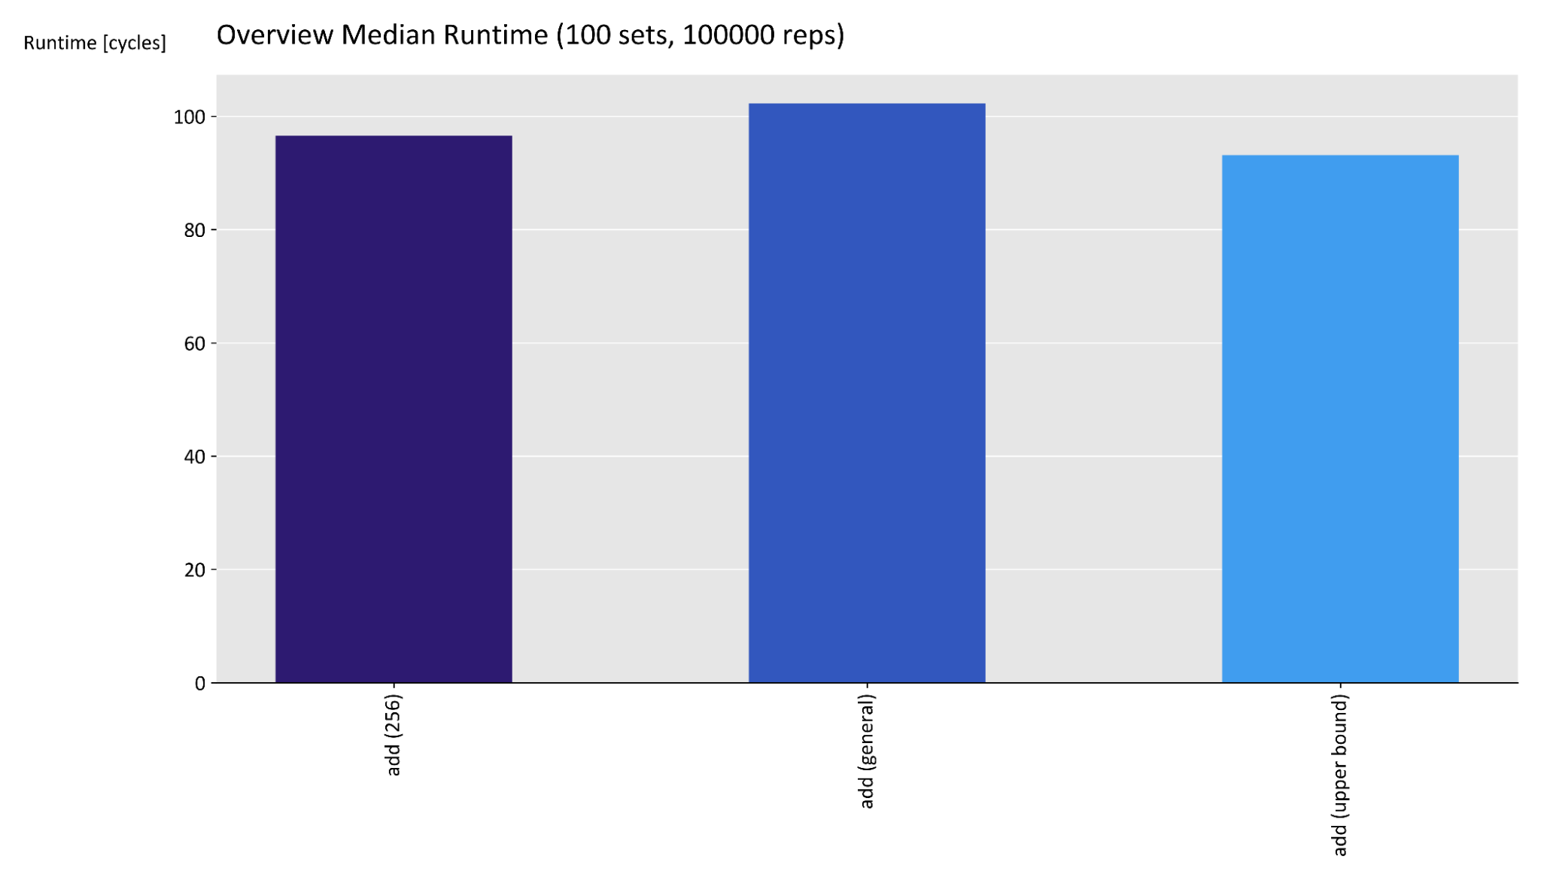
AVX add, sub, mul
Little benefit
Carries
Manually over lanes
Needs #chunks ops
Data movement
Costly in AVX
Notes:
Carry:
Need to manually add carry
Awkward to carry over lanes and registers
Need # chunks operations
Not better than scalar
Algorithms move data around
Gets costly to do with AVX instructions
AVX is not helpful for the most basic algorithms since we need to carry overflows of chunks manually which gets quite complicated to do over lanes and into the next register.
Potentially need # chunks carries which is equally slow than scalar code.
The amount of data movement between chunks is costly for AVX

Slide 31
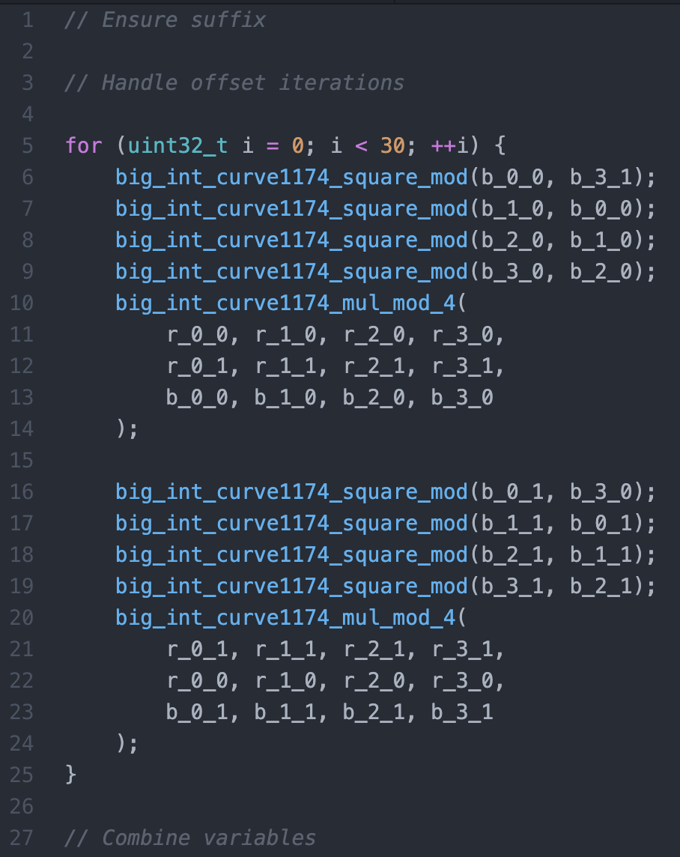
AVX mul 4 indep. inputs
Linear dependency for square operations
Result can use four variables r₁, r₂, r₃, r₄ for independent partial products
Combine at end r = r₁ ⨉ r₂ ⨉ r₃ ⨉ r₄
Loop unrolling to avoid aliasing
Notes:
Not all multiplications can be translated to independent mults
The squaring of the base is linear (needs previous square)
Multiplying r * b also need previous b
But we can split r into four partial products and multiply powers of b to those
And then multiply them together at the end
Unrolling is only necessary, because we have to avoid aliasing
We store b_0 to b_4 and r_0 to r_4 in two variables each.
We use them alternatingly

Slide 32
AVX mul 4 indep. inputs
Pack data
The same chunk from 4 different BigInts are adjacent
Do the normal mul algorithm with vector instructions
No need to move data horizontally
Unpack the data
Moderate speed
Packing/Unpacking is an overhead

Slide 33
Conclusion

Slide 34
Slide Title
Conclusion (1 min) (Freya)
Add overall speedup V1 to V3
Compare to sage and GMP
compare to different laptops (at least teaser)

Slide 35
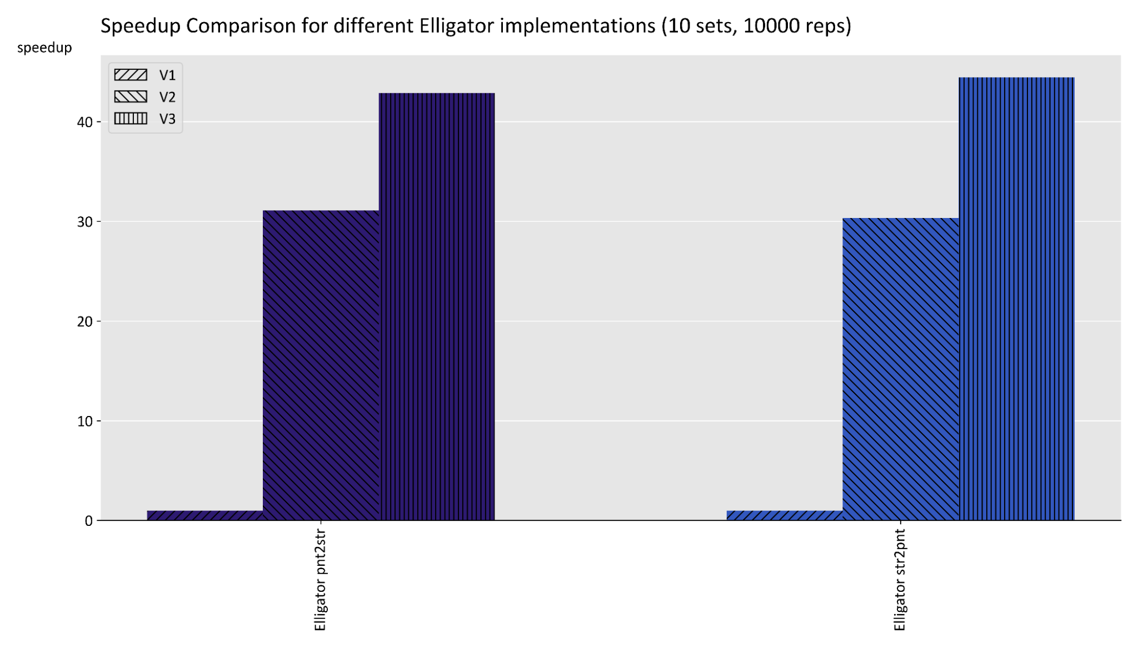
Overall speedup
44x
Notes:
Speedups: pnt2str: ~42.9x, str2pnt: ~44.5x
We got such a great speedup, we are so great.
[If we beat gmp]
We even beat this highly optimised library!
[If we don’t beat gmp]
We looked into the GMP source code and saw that they did some optimisations using assembly.
GMP is a popular library known for being very fast and it has been in development for a long time, so beating it was an ambitious goal.

Slide 36
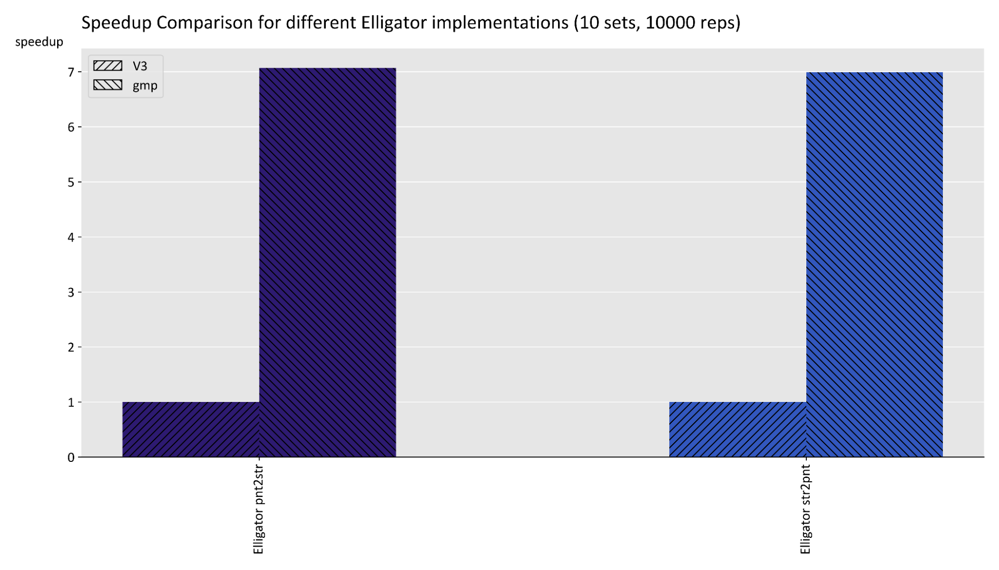
Comparison to GMP

Slide 37
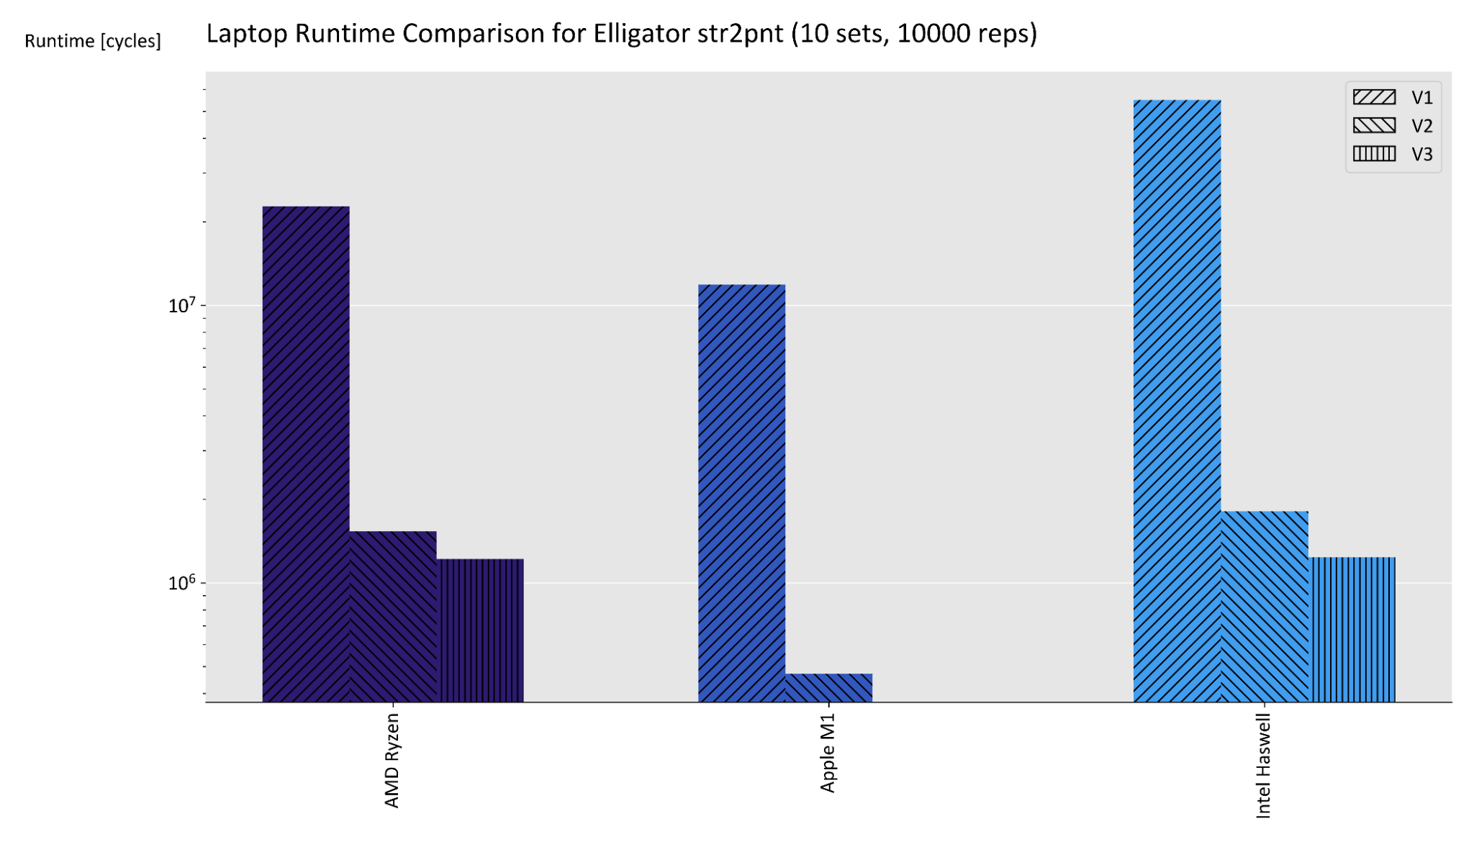
Laptop Comparison
Devices:
MacBook Pro Mid 2015 with Intel Haswell i7-4980HQ 2.8 GHz, native clang
MacBook Pro 2020 with Apple M1, native clang
AMD Ryzen 9 3900X @4.1GHz, Win10 WSL Ubuntu and gcc
Notes:
I’m not sure how much detail we want to include on this just now. We can discuss at meeting :)

